Slide 1
DDOS ATTACKS ANALYSIS based on RF-SVM
Yasaswi Kolasani
CSI 536 Machine Learning

Slide 2
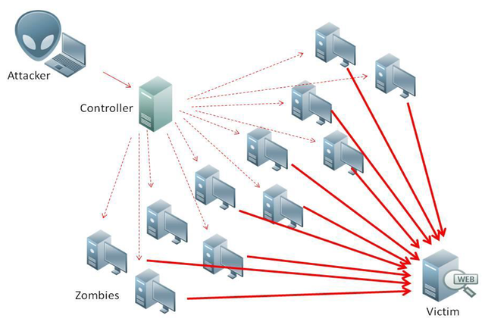
DDOS
Distributed denial of service.
A cyber attack which uses a network of botnets to make a machine or network resource unavailable for the valid users.
Flash crowd.
A sudden increase in the number of requests to a website from users, because of a trusted event that just happened.

Slide 3
Project Motivation
Now-a-days, we can see many attacks in many commercial operations and network environments. One of them is DDoS.
One has to detect this attack well before it occurs so that, our data will be secured and prevent the loss of property to a great extent.

Slide 4

ABSTRACT
Exploiting Random Forest for computing
feature importance.
Used SVM to rescreen the obtained subset with neglected features.
Finally, an optimal feature subset is obtained,
which will reach a higher detection rate and recall
rate.
Source: https://ieeexplore.ieee.org/document/8089926

Slide 5
REFERENCE
Title: Research on DDoS Attacks Detection Based on RDF-SVM.
Authors: Chenguang Wang , Jing Zheng ,Xiaoyong Li
Intelligent Traffic Data Security and Privacy Protection Lab, Beijing Jiaotong University, Beijing, 100044, China.
Shenzhen Medical Information Center, Shenzhen ,518000, China
Source: https://ieeexplore.ieee.org/document/8089926

Slide 6
RF - SVM
Combination of RANDOM FOREST and SVM.
Random forest:
construct multiple decision trees randomly and gains the final classification result by voting.
Used to compute importance values of the features.
3) SVM:
Used to Rescreen the features obtained from random forest by considering each neglected feature in each iteration.

Slide 7
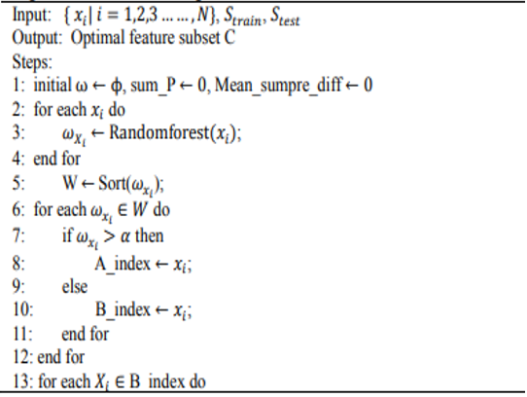
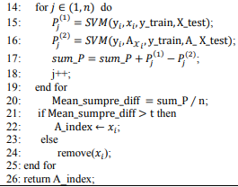
RF - SVM
Source: https://ieeexplore.ieee.org/document/8089926

Slide 8
Advantages
1. Rescreen the features and prevent from deleting the features,
useful for DDOS.
2. DDoS attack traffic Vs Flash Crowd traffic.
3. Suppress the attacks before it reaches.
4. Detect known and unknown attack.

Slide 9
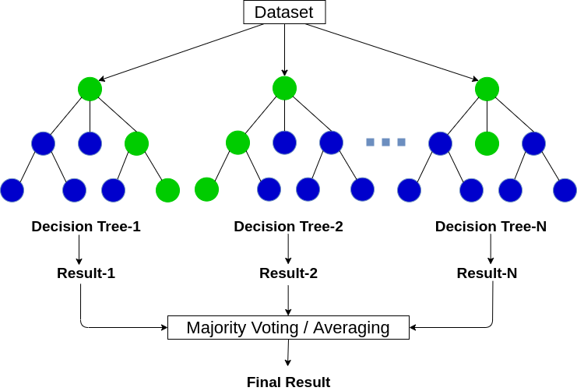
Random Forest
Image Source: https://www.tibco.com/reference-center/what-is-a-random-forest

Slide 10


Concept behind importance values
Supervised learning
Measure the disorder of grouping by the target variable
Entropy of the Y given x
Information gain

Slide 11
KDD99 DATASET
Contains 42 features among which last one is the target variable.
Contains 494020 rows.
Need to Preprocess the data
Convert Object data types to integers.
Remove duplicate data.
Normalizing the data.

Slide 12
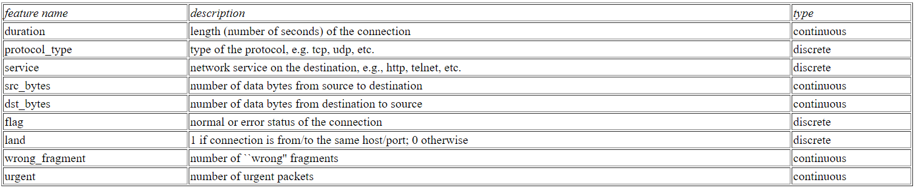
KDD99 DATASET

Slide 13
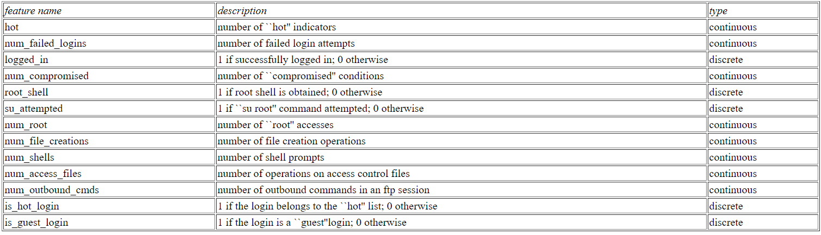
KDD99 DATASET

Slide 14
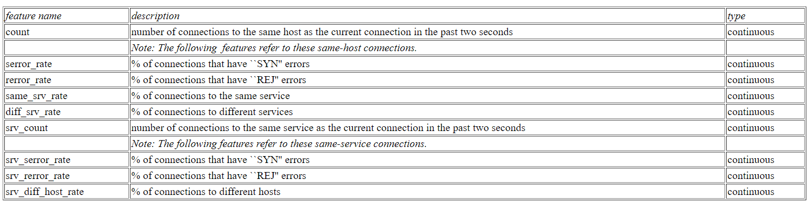
KDD99 DATASET

Slide 15
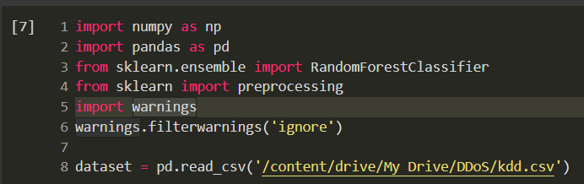
Implementation
Importing Modules and Loading Dataset

Slide 16
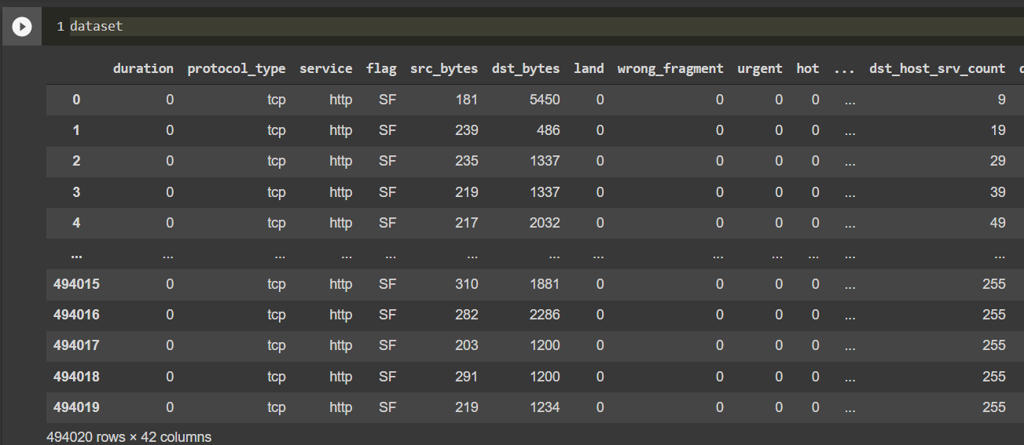
Contd..
Image of dataset

Slide 17
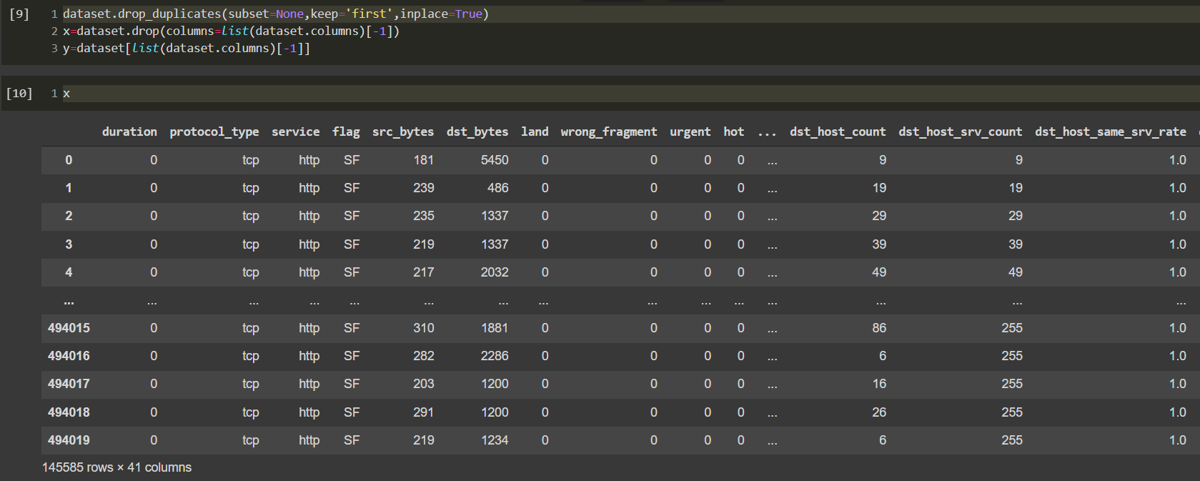
Contd..
Dropping duplicates and separate the target variable.

Slide 18
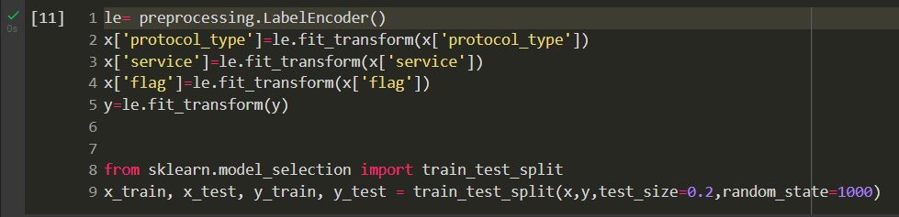
Contd..
Using label encoder to convert categorical data to numeric values.

Slide 19
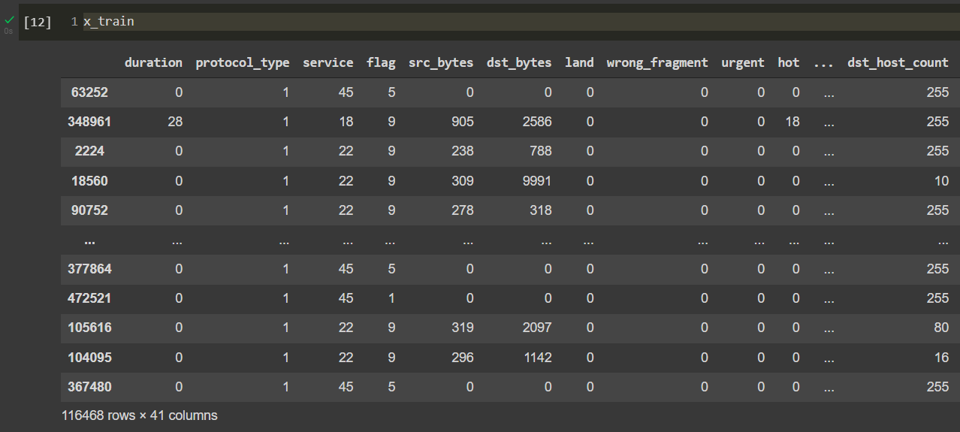
Contd..
Data after Label encoding.

Slide 20
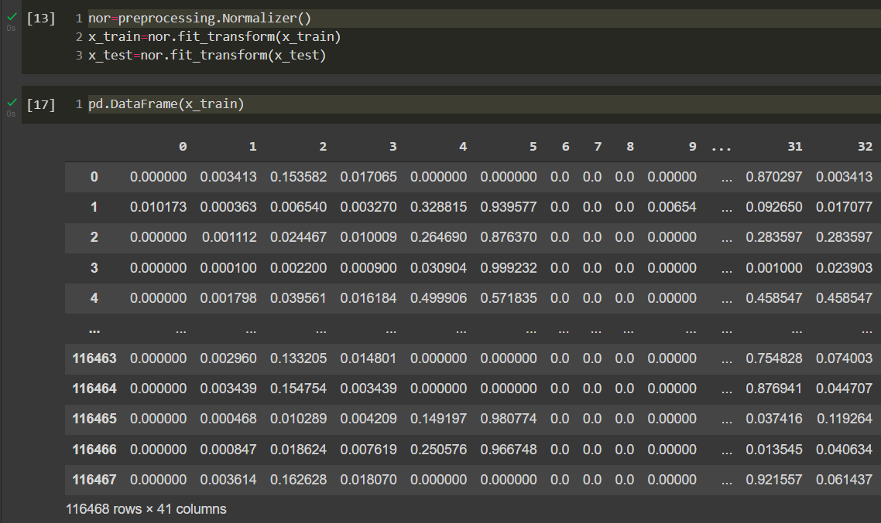
Contd..
Normalizing data for SVM and print the normalized train data

Slide 21
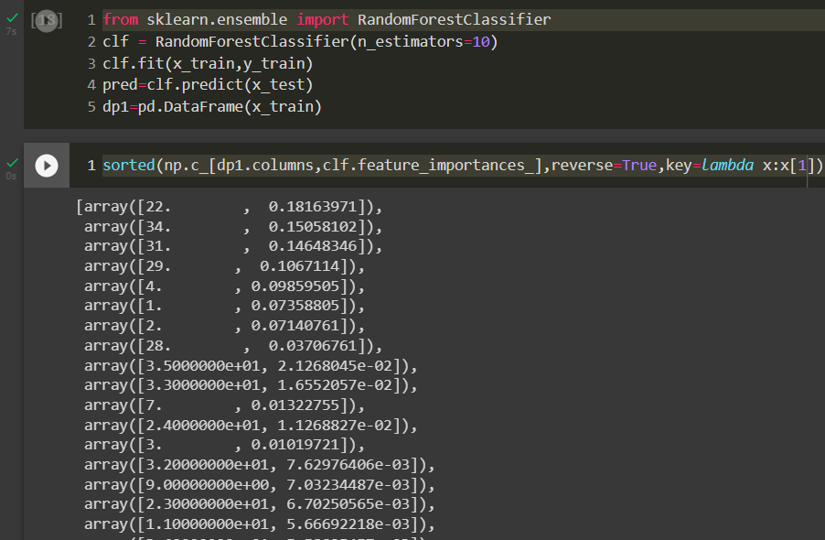
Contd..
Using Random Forest classifier to compute feature importances and print array of features with respective importance values

Slide 22
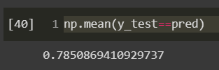
Results
It is the array of (feature, Importance value) values in an descending order of feature importance.
We select the features having the high importance values above the threshold value.
Accuracy of random forest.
We need to improve it by rescreening the features with SVM.

Slide 23
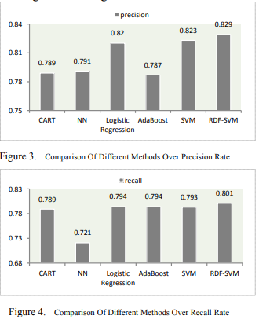
Expected Results
Random forest will select up to 20 features and after rescreening 3 more features will be added to the subset resulting the optimal subset with higher detection and recall rate
The model is compared with different algorithms and show that RDF-SVM gives highest precision and recall.
Source: https://ieeexplore.ieee.org/document/8089926

Slide 24
Milestone
Date | Topic
17th Feb 2022 – 1st Mar 2022 | Pre-processing of data
2nd Mar 2022 – 10th Mar 2022 | Compute Feature importance using Random Forest
11th Mar 2022 – 15th Mar 2022 | Get Optimal Feature Subset using SVM
16th Mar 2022 – 25th Mar 2022 | Compare RF-SVM Model with different algorithms
5th May 2022 | Final Project Presentation

Slide 25
SUMMARY
Used Random forest to get Feature subset by computing feature importance values.
Rescreen the obtained feature subset with SVM to get the optimal feature subset with higher classification performance.
Besides, Which detect known and unknown attacks and differentiate between Attack and flash crowd.
Suppress the attack before it occurs.

Slide 26
Thank You

